Slide 1

Customer Base Analytics In E-Commerce
Exploration | Insights | Actions
Sanjeev Kumar Jha
12-Dec-2020

Slide 2
Methodology
Plan the activity and communicates with clarity.
Engages the customer onsite and Understands the current situation.
Defines the scope, Objectives, methodology, timelines.
Collect Data and Processes the same.
Analyze the data, build Models and derive insights.
Presents insights to client via reports, dashboards on agreed timelines.
Present Final Report and close the engagement.
Define
Plan
Design & Build
Analyse
Deliver
12-Dec-2020

Slide 3
Project Pipeline
Planned
3 Days
1 Week
2 Week
2 Week
1 Week
Business Understanding
Data Under-standing
Data preparation
Segmentation
Evaluation
3 Days
1 Week
6 Week
2 Week
1 Week
Actual
12-Dec-2020

Slide 4
Process
Business Understanding
Data Preparation
Exploratory Data Analysis
Key Insights/Metrics and KPIs
Customer Based Analysis
Customer Segmentation
12-Dec-2020

Slide 5
Business Understanding
Companies Background:
ABC is a fashion category multinational company with a turnover of more then one billion dollars. It has 40 factories across the globe.
ABC is a profitable company which makes money using their E-commerce website and few other marketplace like Amazon and Flipkart.
ABC products are sold through online and offline channels both company owned and with partners.
Their clients includes - Victoria’s Secrets, Marks & Spencer, Triumph, Speedo, Calvin Klein among others.
Business is looking to increases customers base and revenue based on there past purchase behaviors/ shopping pattern to cross sell and up sell there products.
Customer Segmentation modeling technique is used to understand the demographics of customers and try to divide into different segment based on there behavior and giving some recommendation
12-Dec-2020

Slide 6
Data Understanding
The dataset contain one year sales data from Jan-Dec 2019.
Data contains :
35 features, which are - Order No, External Order No, Order Date, Order Type, Status, Customer Name, Country, State, City, Email, SKU Code, Style, SKU Desc, Category1, Sub Category, Size, Color, Type, Quantity, Return Qty, Order Currency, Price, Ship Cost, Packing Cost, Discount, Discount Code, Tax, Invoiced, COGS, Invoiced In Base Currency, Gross Margin, GM Percent, Primary Vendor, On Hold Status and Replacement Order
12-Dec-2020

Slide 7
Data Understanding
Few important features in the data are Order number, Order Date, City, SKU Code, Size, Color, Quantity, Invoiced, Gross Margin
Feature Description:
Order number : Auto generated Order number in order management system
Order Date :- Exact time of the order
City :- Order placing city
SKU Code :- The SKU code (product code) ordered by the customer
Size :- Product Size
Color :- color name given by the designer
Quantity :- Qty ordered per SKU
Invoiced :- invoiced to the customer
Gross Margin :- percentage of profit made on invoiced amount
12-Dec-2020

Slide 8
Data Preparation
For any business, data preparation is the most important step as it improves the data quality and increases the overall productivity
Below are the few techniques which has been used for the data cleaning :
Creating Unique Order No. :- Dataset contain multiple Order number for same product purchase (as it’s taking one row for every unit purchase) Solution to this is creating a new order number by matching Order No and SKU Code
Removing Outlier:- Based on Invoiced amount removed the outlier (these are retailer. Will treat them separately)
12-Dec-2020

Slide 9
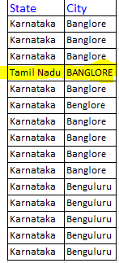
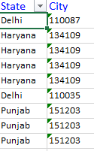
Data Preparation
Huge amount of time has been spent on cleaning the city. Prominent issues with the city columns are:-
Similar names for same city. E.g. Bangalore , Bengaluru
Whole address or just the pin code in city column
Some cities like Bangalore is tagged to Tamil Nadu, Delhi etc.
12-Dec-2020

Slide 10
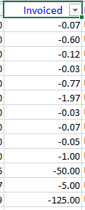
Data Preparation
Invoiced feature has some negative values
Upon check with business, we found that these are few dissatisfied customer who has been rewarded with free gift items.
Removing negative value from invoiced has been suggested.
12-Dec-2020

Slide 11
Exploratory Data Analysis
Exploratory Data Analysis is used to analyze the data sets to summarize their main characteristics, often with visual methods like graphs and lists.
Below are the outcome from EDA :
12-Dec-2020

Slide 12
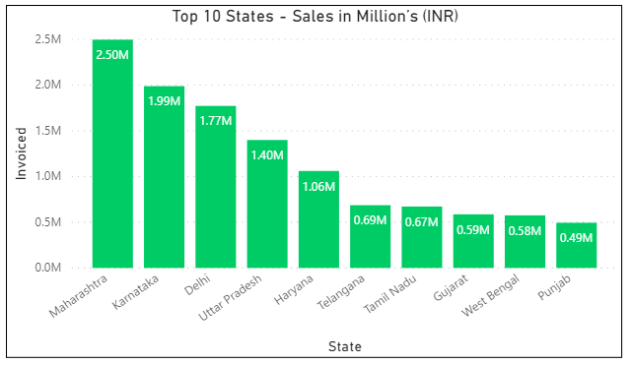
Exploratory Data Analysis
Geographic Heat map of India
12-Dec-2020

Slide 13
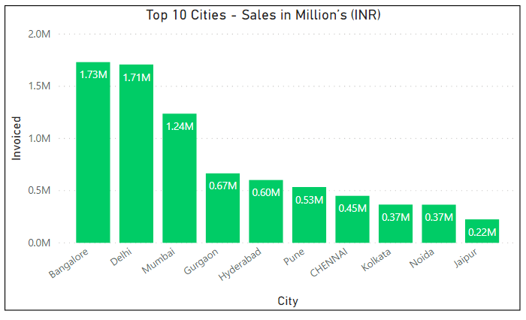
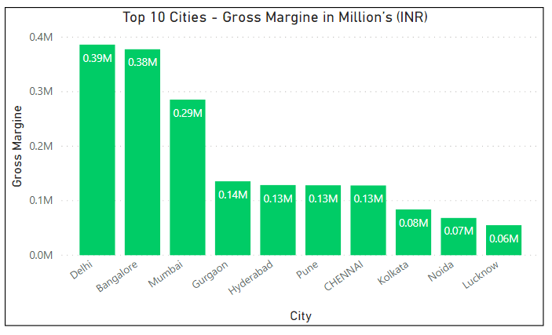
Exploratory Data Analysis
12-Dec-2020

Slide 14
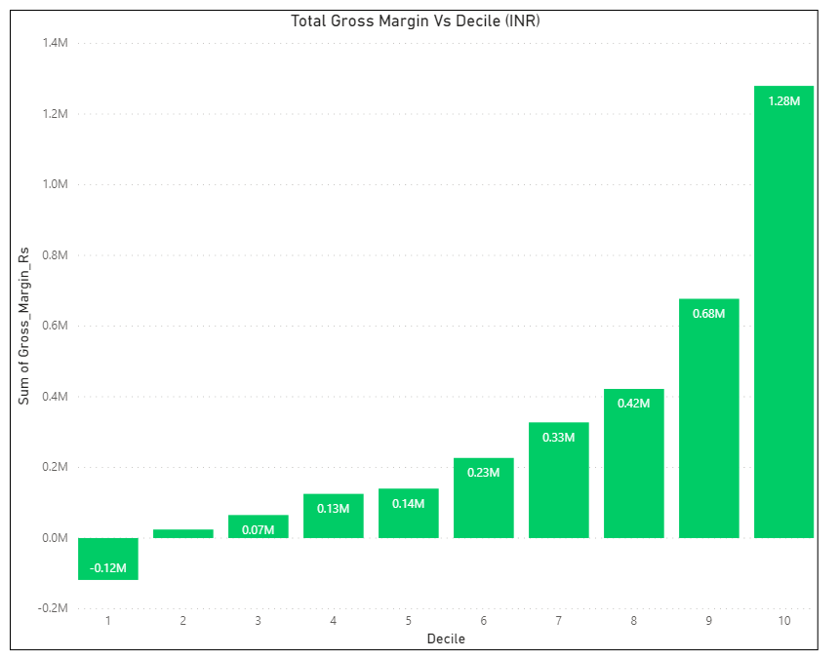
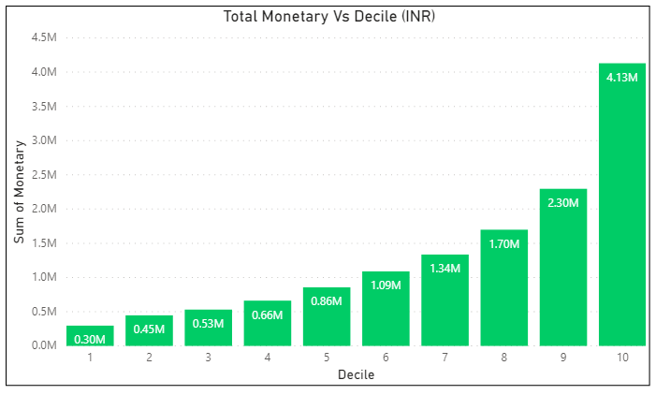
Exploratory Data Analysis
12-Dec-2020

Slide 15
Key Insights
Customer growth is not proportional to revenue growth Need to Focus on Customer Acquisition
Top 10% give 30% revenue – retain
3 segments possible based on revenue
Low Recency of high value segments: Need early intervention
Upsell Potential in Medium value segments
Targeted campaigns and offers
12-Dec-2020

Slide 16

2019 Jan to Dec
Key Metrics and KPIs
Sales Value in Lakhs
151.8
Average Monetary Value in INR
2324
Sales Volume (Qty)
19866
Average Revenue per transaction
1774
Unique Customers in 2019
8670
Average Recency in Days
123
Average % of Returning Customers in 2019
21.8%
Average Frequency
Twice in Year
Gross Margin in 2019
27%
12-Dec-2020

Slide 17
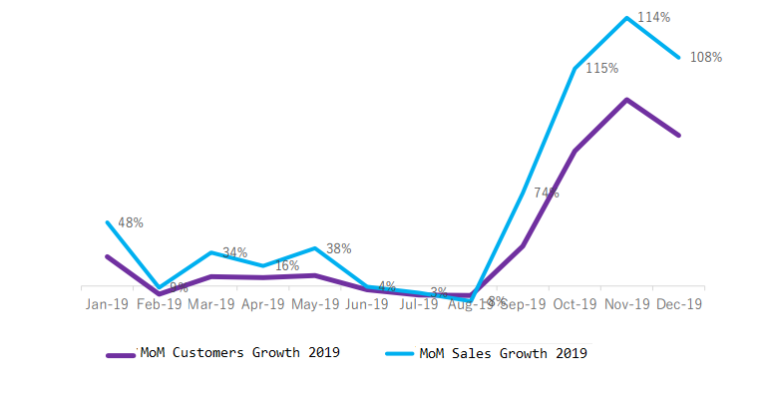
MoM Customers and Sales growth
More than 200% growth in customer count from Sep 2019
But, proportional growth in sales is only 100%
Recent acquisitions/visits are low value transactions
12-Dec-2020

Slide 18
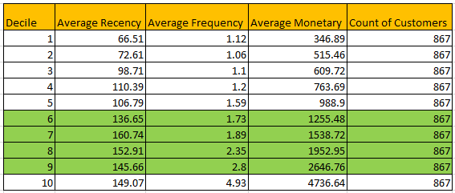
Decile Analysis
30% of the Sales revenue is from 10% of Customers
Top decile is 13 times better than worst decile and Twice better than the second best decile
10% of sub base will give 30% revenue
3 segments as suggested by customer base analysis
Top decile is not recent!
Recent acquisitions/visits are low value transactions
12-Dec-2020

Slide 19
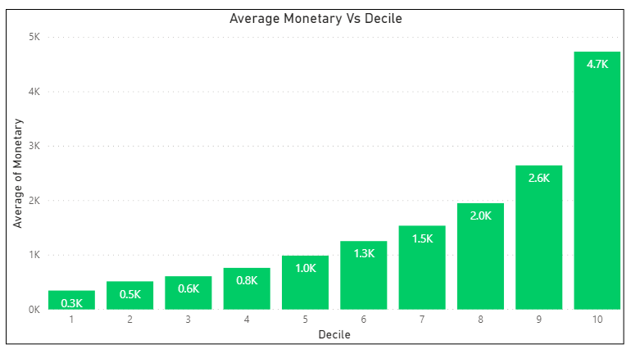
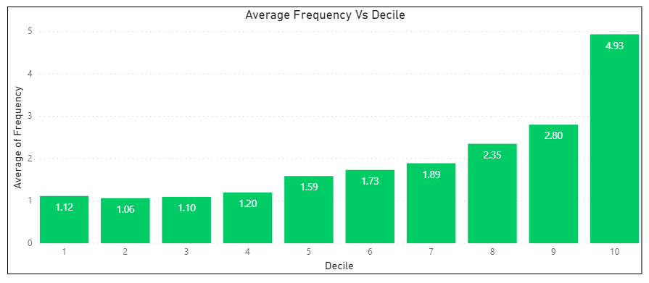
Decile Analysis
12-Dec-2020

Slide 20
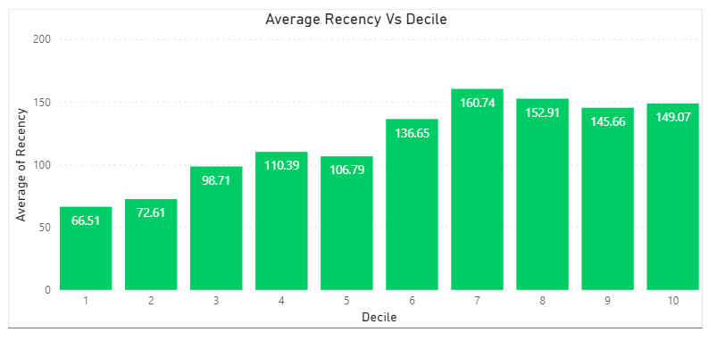
Decile Analysis
12-Dec-2020

Slide 21
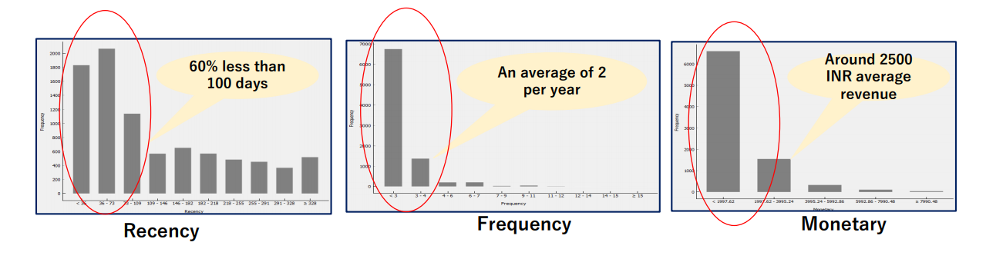
Key Discovery – RFM Analysis
12-Dec-2020

Slide 22
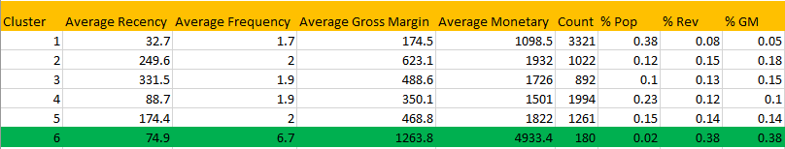
Customer Clusters and Profiles
Average Recency 123 days
Total No. of Unique Customers 8670
Average Frequency 1.97 Times/Year
No. of Products Bought (Avg) 02
Cluster 6 is the Most Profitable Cluster But, not recent
12-Dec-2020

Slide 23
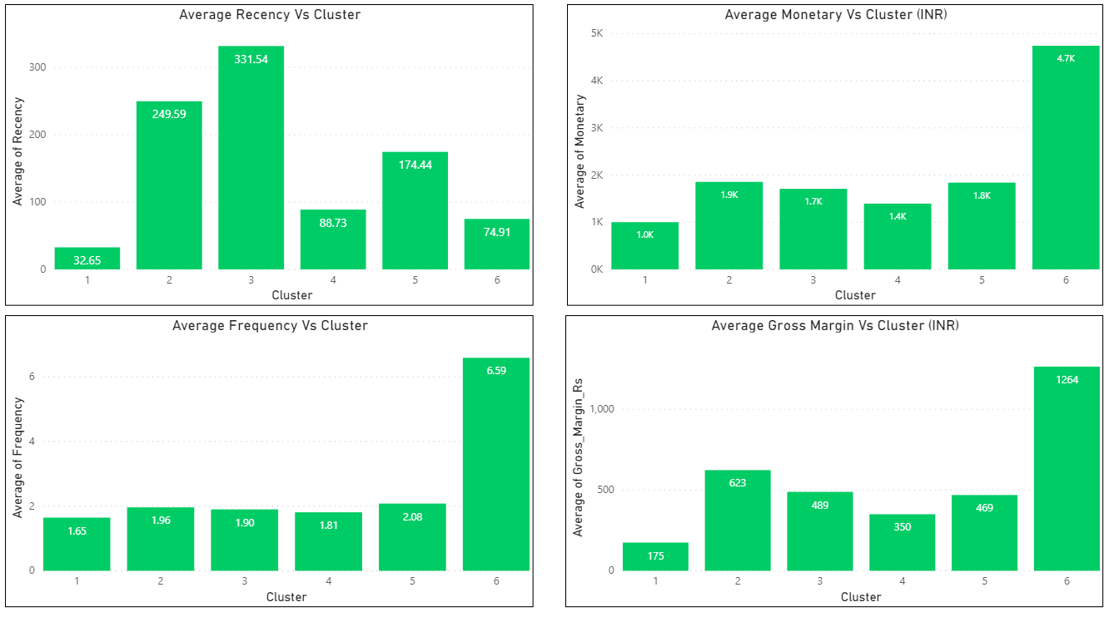
Customer Clusters and Profiles
12-Dec-2020

Slide 24
Customer Base Analysis
 |  | Recency |  |  | Description
 |  | L | M | H
Monetary | H | 522 | 200 | 235 | Stars
 | M | 1895 | 765 | 1087 | Cash Cows
 | L | 1001 | 940 | 2027 | Potential - One Timers
• Recency – Indicates Behavior
• Monetary – Customer Value in INR
12-Dec-2020

Slide 25
Special thanks to Dr. J. B Simha and Dr. Shinu Abhi for their guidance and all the support on this initiative.
Thanks Ashish Chandra Jha for Collaborative work support
12-Dec-2020

